Slide 1
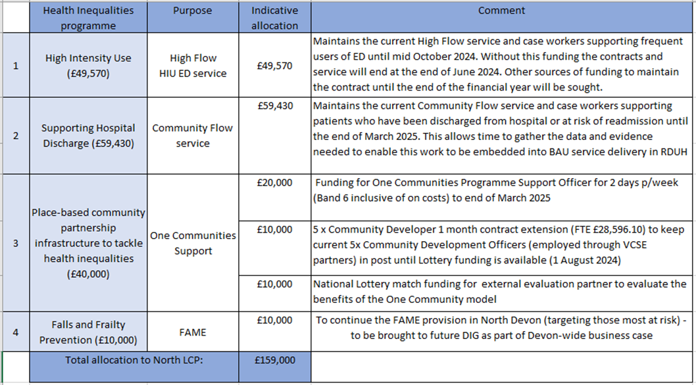
OND LCP Health Inequalities ICB allocation – 24/25
NOr

