Slide 1



Our Future Hospital Stakeholder Briefing Zahara Hyde Director Estates & Facilities
14 August 2024

Slide 2

Our Journey So Far
2019: Inclusion of North Devon District Hospital in the Government programme to address the worst NHS estates
2020: Our Future Hospital programme was set up in as NDDH response
As a Public Dividend Capital (PDC) funded project it is required to submit a series of business case stages to secure treasury approval
2021: a Strategic Outline Case for OFH was submitted
2024 – Hospital 2.0 launched as standard for all new hospitals; August - new Govt announces review of budgets and timelines
Notes:
2019 – mention allocation of £250m
2021 – SOC based on £250m

Slide 3





Our Ambitions - have not changed since 2020!
Fit for future estate
Infrastructure to deliver quality advanced care
Reduces maintenance costs/ temporary facilities
Thoughtfully accessible
Fit for future services for our population
Equitable access and outcomes for all
Recognises future population health needs
Clinically and financially stable, high quality safe service
Right care, Right place
Local where possible, networked where beneficial
Aligns with the Devon System
Digitally Optimised
Connected care
Patient accessible
Mitigates rurality
Fit for future workplace
Promotes staff health and wellbeing
Good place to work

Slide 4




Fit for Future Services Our Clinical Strategy (July 2023) Right Care Right Place
Local acute and emergency care
Safe and effective acute care within respective localities
Minimise length of stay
Reduce unnecessary emergency department attendances and admissions
Expand same day emergency care and “hot clinic” models
Expand out of Hospital services using technology eg virtual wards/hospital at home
Local elective care
Provide elective care as close to the patient as possible in the most efficient way
Utilise technology to enable patient-initiated follow-up (PIFU) and virtual follow up
Interdependence and integration will vary across services:
Well established departments at both acute hospitals, working largely independently
Services which need to be provided at both localities in order to support care of patients admitted acutely unwell, impacted by staffing at NDDH
Specialists based at one locality with established visiting services
Services provided at only one site to maximise capacity & capability
Community and primary care led services
Deliver care as close to people’s homes as possible – manage long term conditions with effective use of resources
Drive full integration of our acute and community teams
Make maximum use of our community estate
Promote health and wellbeing
Develop first contact practitioner roles and frailty hubs
Expand secondary elective care into the community
Improve end of life care
Tertiary care and areas of national clinical and academic excellence
Maximise our academic and research profile
Collaborate with local and regional partners to provide specialist care
Centralise our specialist services on one site (either East or North)
Build on strengths

Slide 5
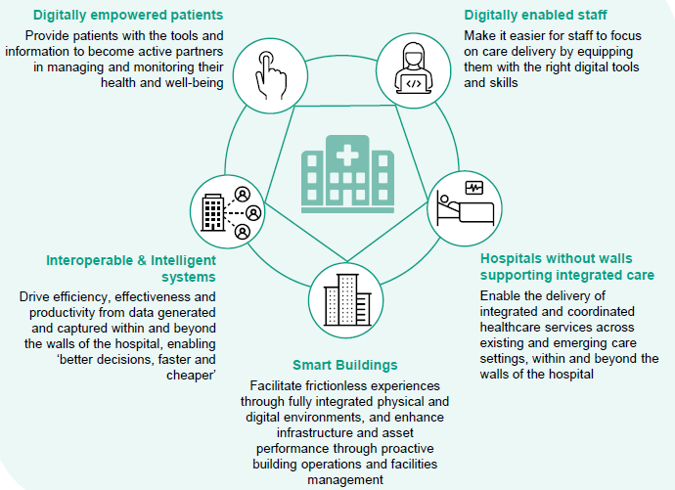
Digitally Optimised
Our Digital Strategy (July 2023)
Technology in Action:
Epic EPR installed
Patient portal live
Royal Devon virtual ward – largest Epic remote monitoring in Europe
Robotic surgery at RDE and NDDH from June 2023

Slide 6
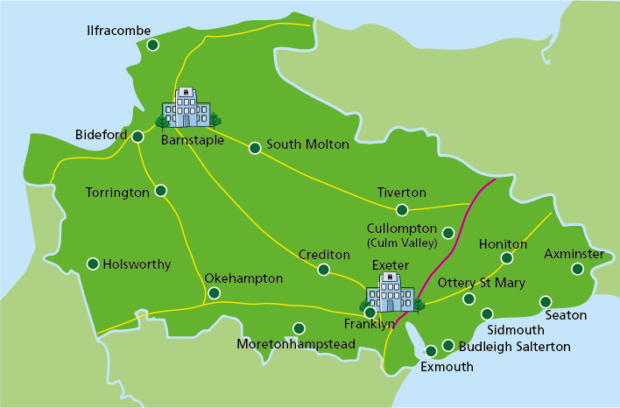
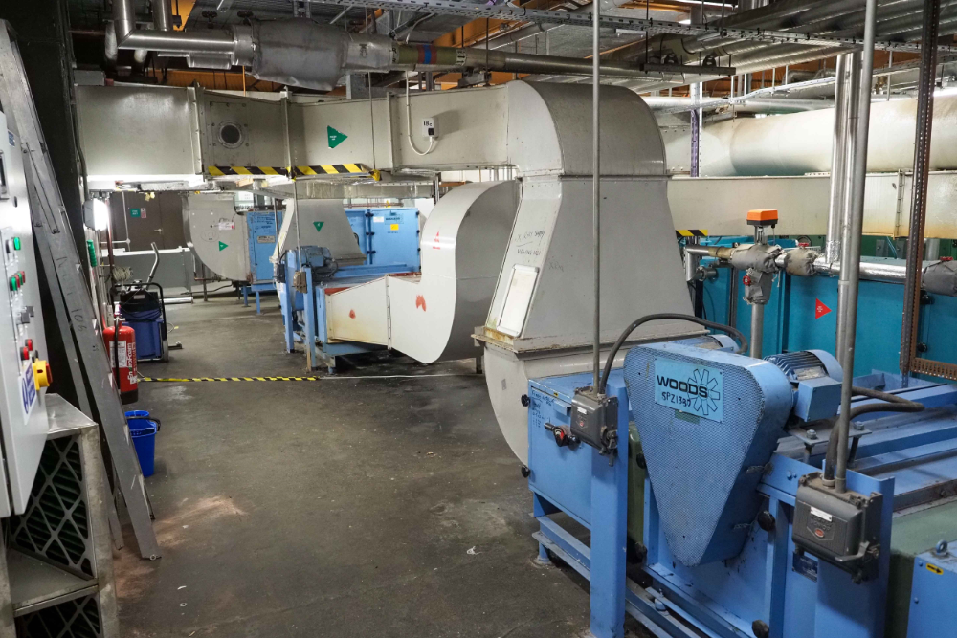
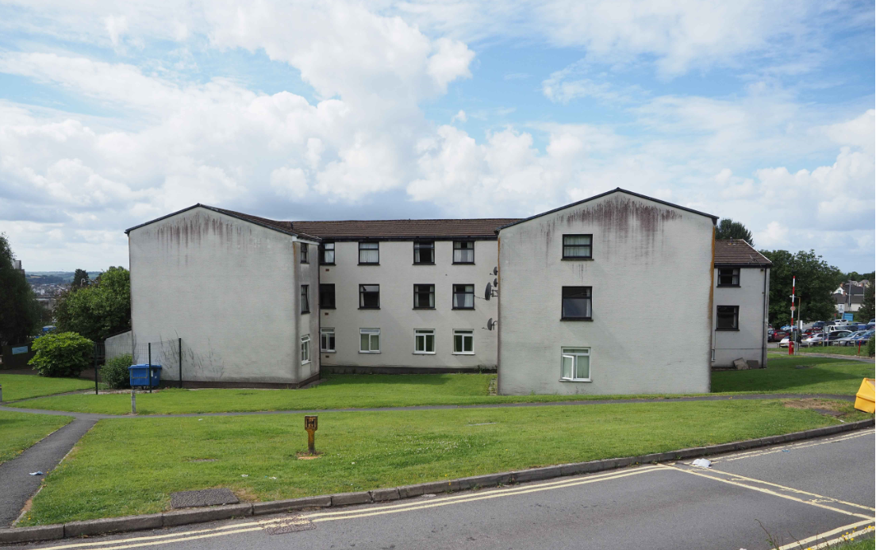
Fit for Future Estate NDDH Challenges
Estates risks
Updated 6 facets survey - rising critical/high risk maintenance backlog (ca £40m vs £37m when project begun) with overall risk of >£80m.
Highlighted major functionality and operational issues with Theatres, ICU, Endoscopy, parts built 50 years ago - Critical Risks paper jointly developed
Minor improvements through Jubilee – orthopaedic – ward and Discharge Lounge, Tiverton endoscopy underway
Fit for Future Workplace
Pre-works to enable demolition and rebuild of oldest staff accommodation blocks

Slide 7
OFH SOC Refresh for NHP 2024
Hospital 2.0 is a standardised design and construction toolkit that sets new build/clinical standards for our project
The 2023 NHP Programme Business Case set out significant new build increase for NDDH – major redevelopment of the existing site
August 23 – Trust agreed at Board that a revised phased plan approach based on:
Building for the future – demand and capacity to at least 2040
Flexible and adaptable spaces
Great place to work – staff health and wellbeing facilities
Maximising service integration across sites to give best patient care
Multidisciplinary models of care, technology-enabled
Local “grow your own” schemes for nursing (CMO report 2019) and other professions

Slide 8
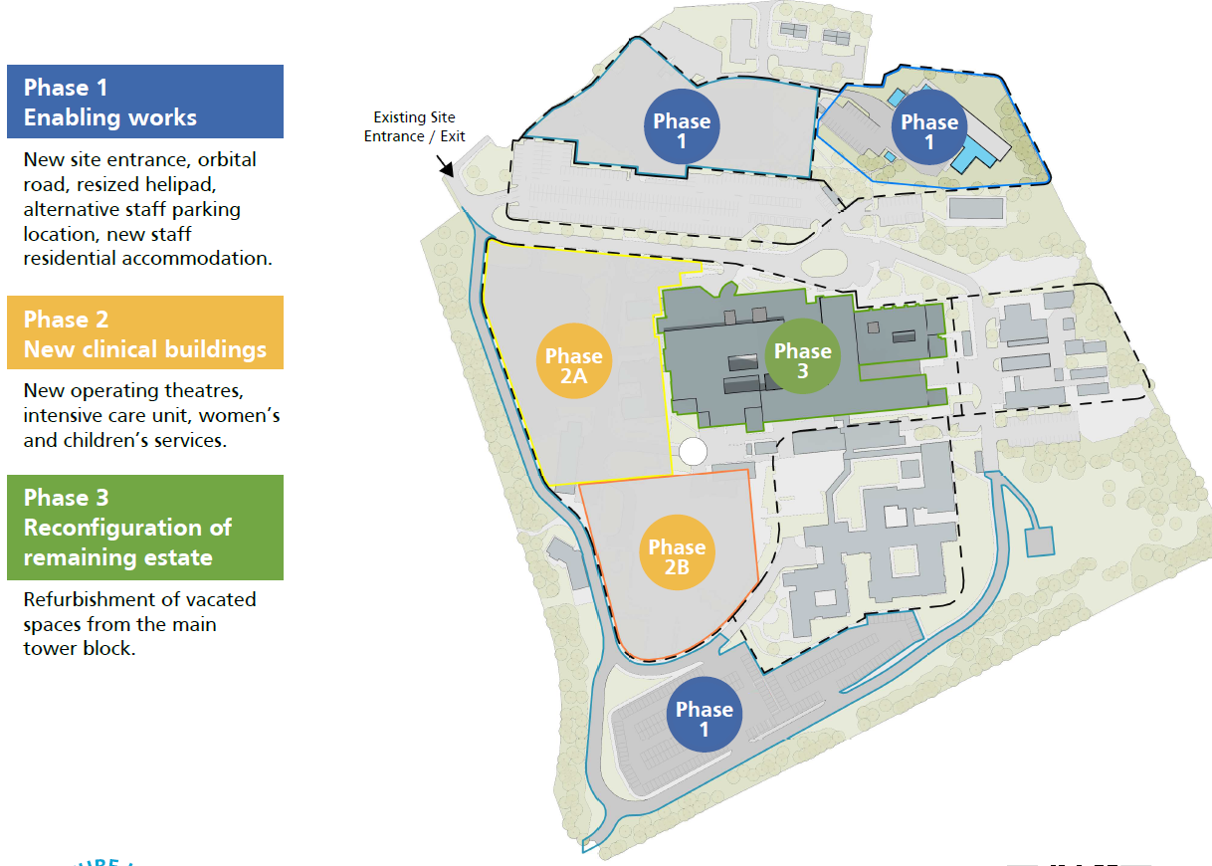
Phasing plan for NDDH redevelopment

Slide 9
Transport and OFH?
Staff – travel to work
Green zone; showers and cycle sheds; cycle routes?
Future growth in staff numbers – public transport?
Space restrictions - car parking
Cross site working travel (NDDH-Wonford-community sites
Patients/visitors – travel to services
Urgent and emergency care – service to patient
Specialist care – patient to service (centralised centres of excellence)
Community services; technology solutions vs workforce
Limited car access; reliance on public transport links
Facilities Transport
Laundry; sterile services; equipment; lab samples; other supplies
Estates Transport
Supporting an 8-10 year multi million £ construction project
NHS Decarbonisation Target

