Slide 1
Ilframcombe JUNIOR SCHOOL 2024-25

Slide 2
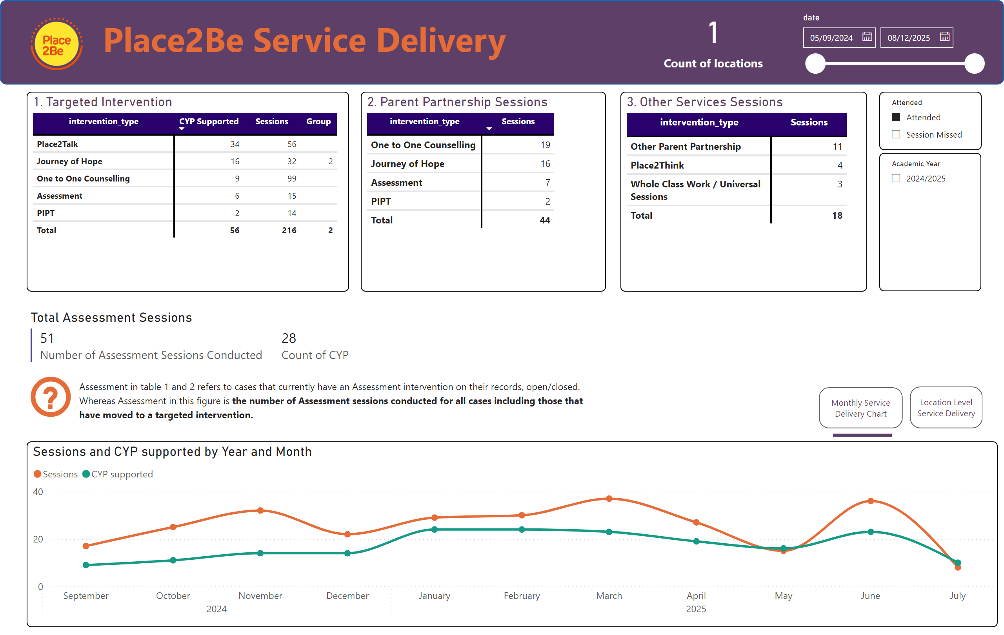
Service Delivery-
Notes:
*Total assessment sessions 51 for 28 individual children- not all children have then proceeded into targeted support.
**Children may have been assessed for multiple interventions
***Plave

Slide 3
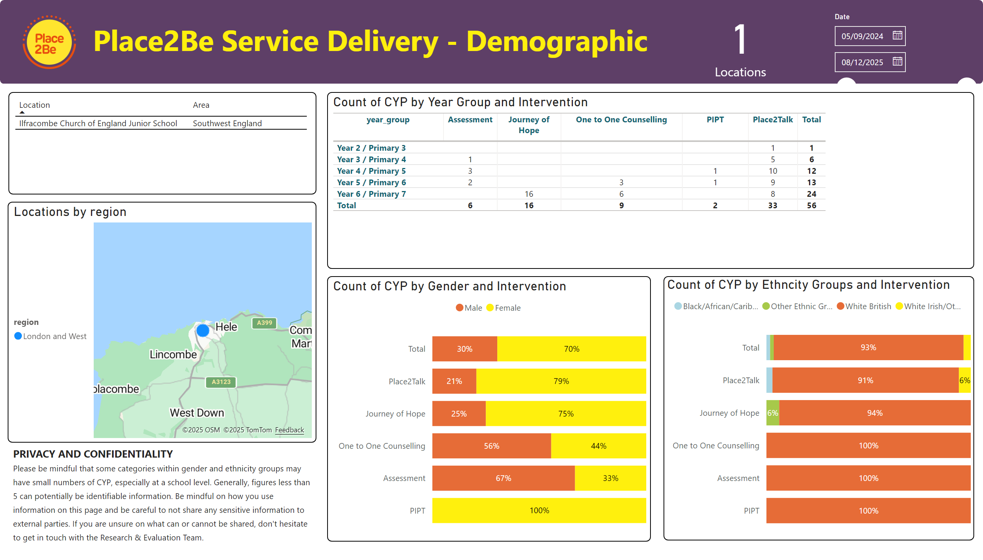
Demographic

Slide 4
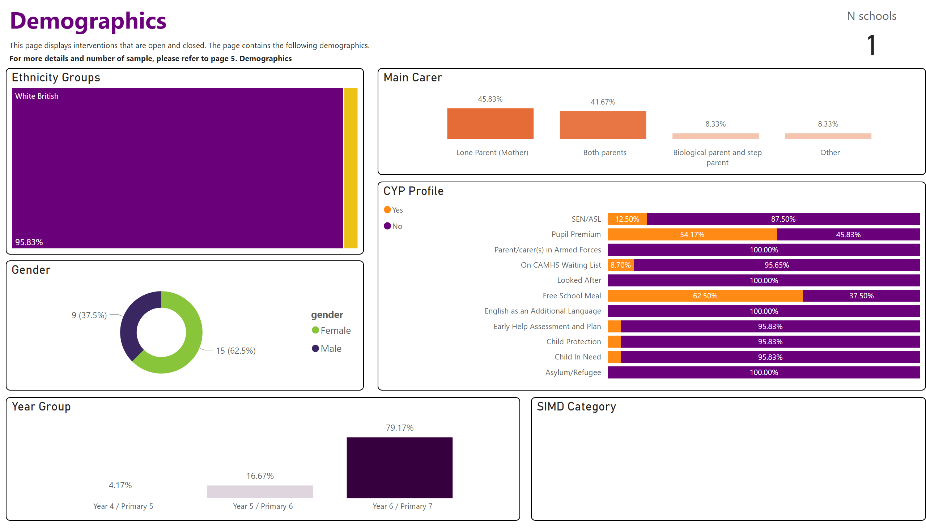
CHARTS 5. Demographics

Slide 5
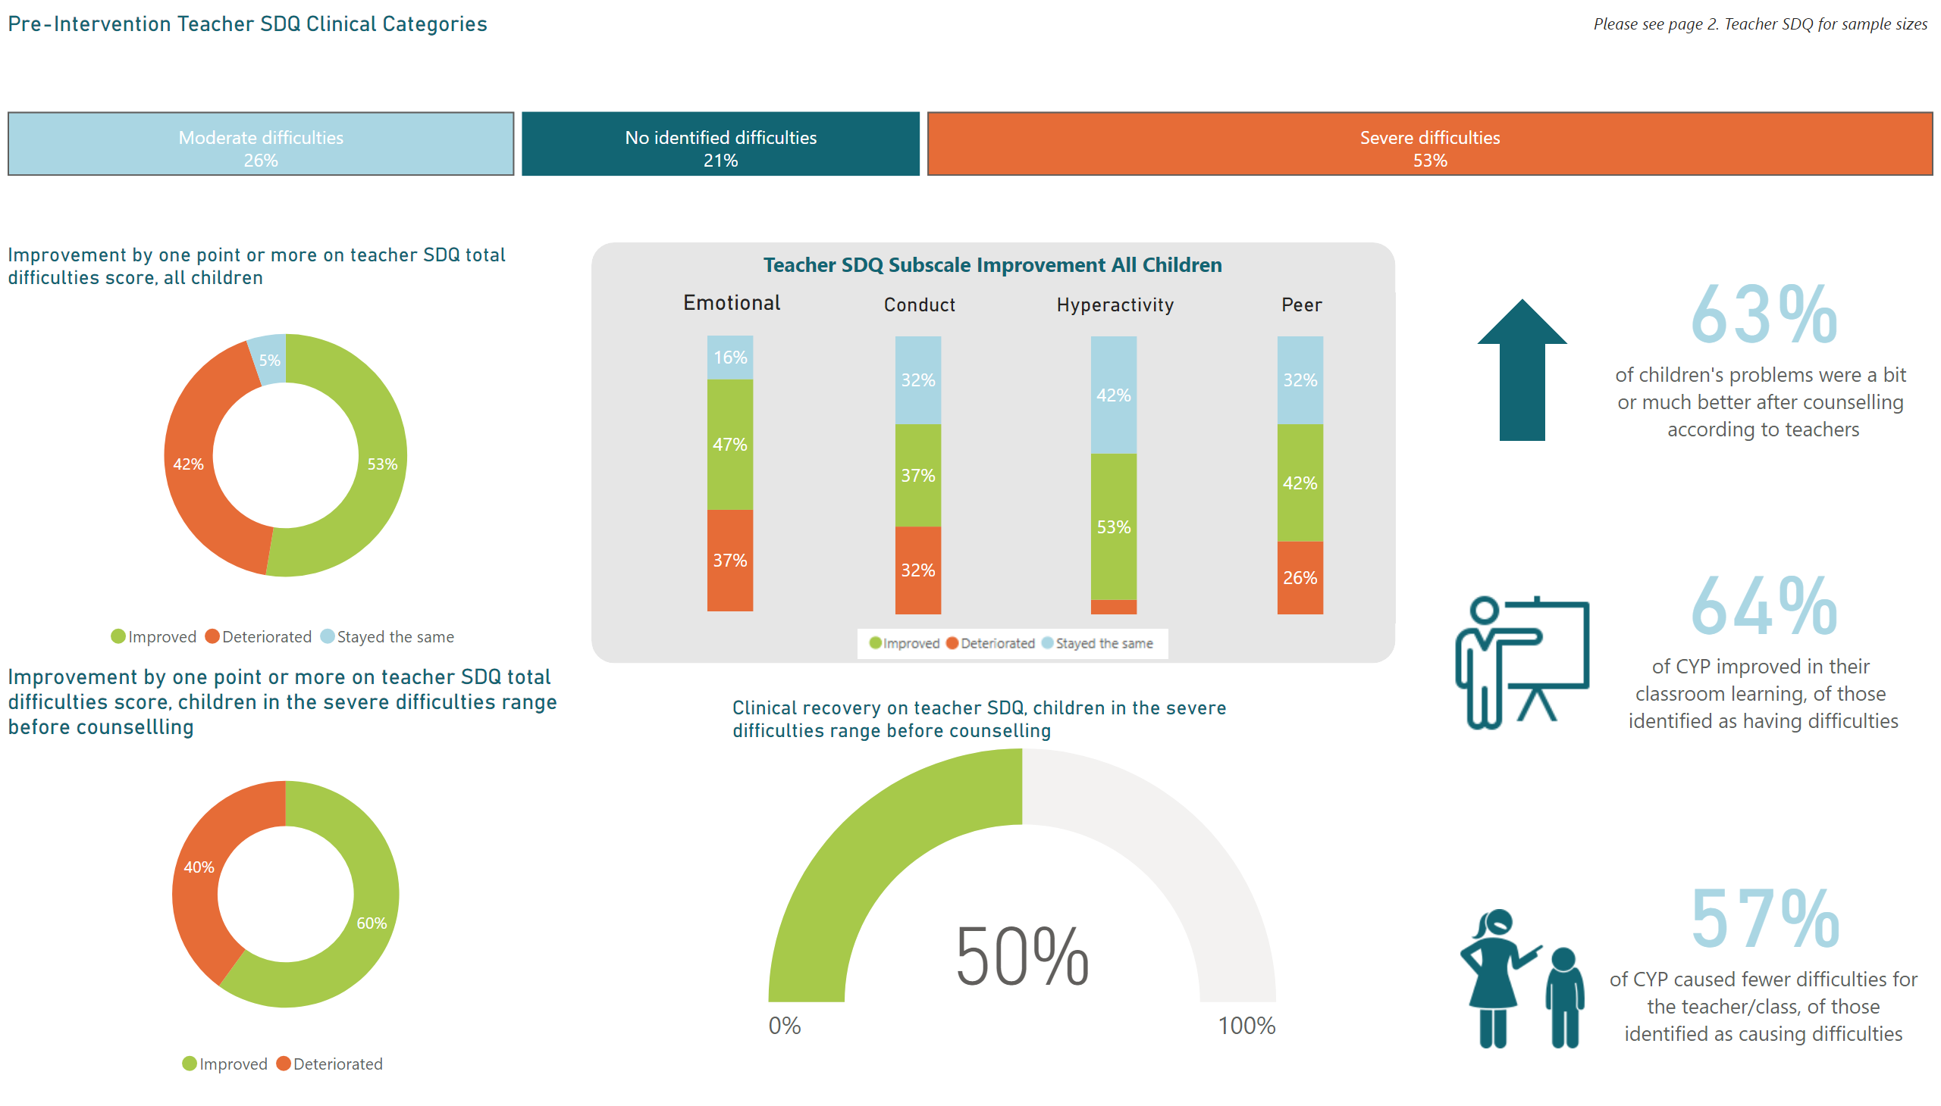
CHARTS 2. Teacher SDQ

Slide 6
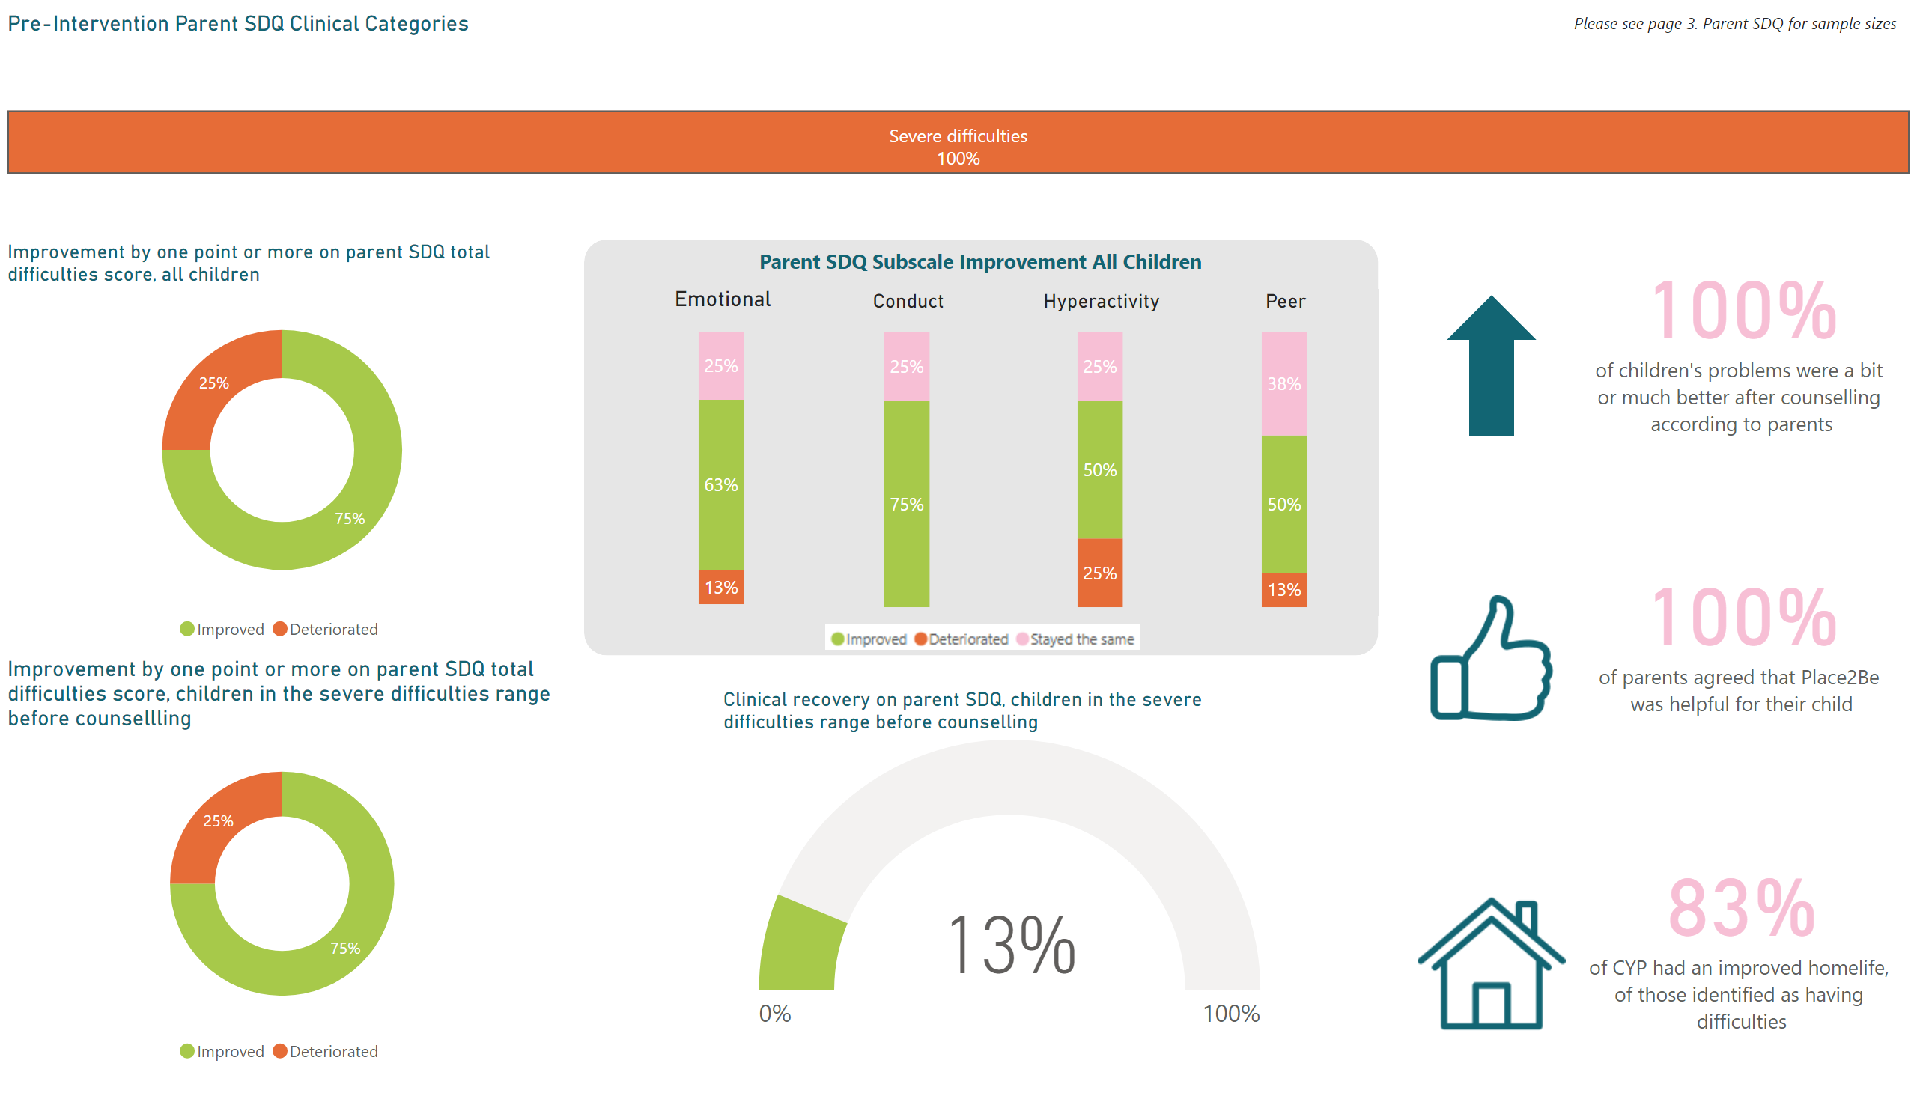
CHARTS 3. Parent SDQ

Slide 7
One2one counselling- Goal Based Outcomes
One2one counselling Goal based outcomes
Closed cases | 8
Closed cases with at lease 1 valid goal | 8
Closed cases with 1 valid goal with outcomes | 5
Number of CYP who improved | 5
Number of CYP with no change | 0
Number of CYP who deteriorated | 0

Slide 8
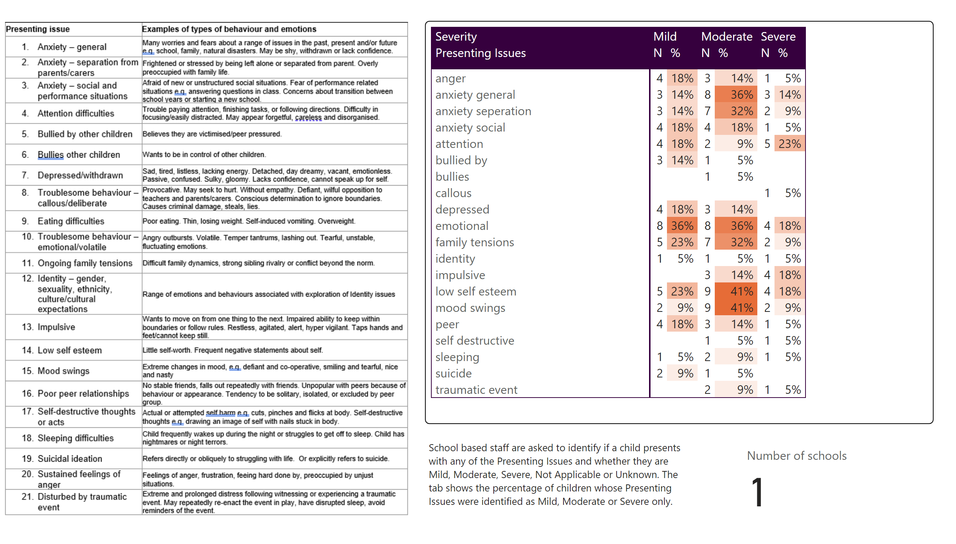
Presenting Issues Severity

Slide 9
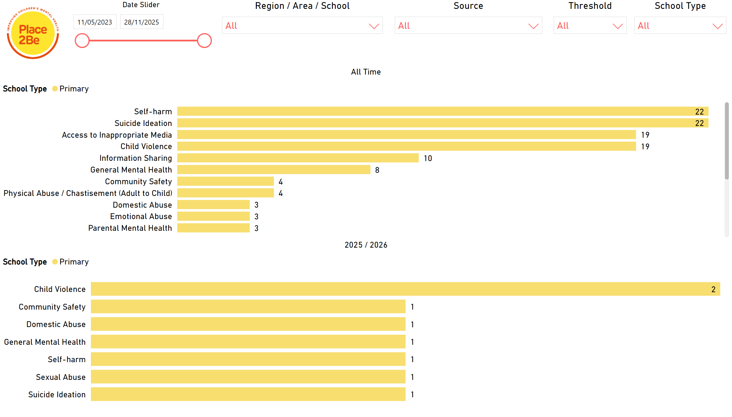
3b. Safeguarding Issues (Total Count)

