Slide 1

Integrated Pathways – closing the gap
OverView of Proposal of work
March 26

Slide 2
Overarching Aim:
To mobilise a small pilot based within existing service offers to explore what barriers can be reduced to offer a more seamless shared flow of service. To explore sharing information, risk and care plans of known service users.
To focus on a small neighbourhood to test and learn what shared care/integrated offers could look like/require to be successfully implemented then at pace and scale.

Slide 3
Drivers for pilot
Feedback from system wide workshop identified areas of challenge
Aligned with work in DPT around managing thresholds and sharing assessments
Known issues with service users not being able to access more than one service at a time or having multiple but not joined up interventions
Lack of shared care pathways/plans for HIU’s leading to lack of optimisation of delivery
Aligns to neighbourhood framework requirements

Slide 4
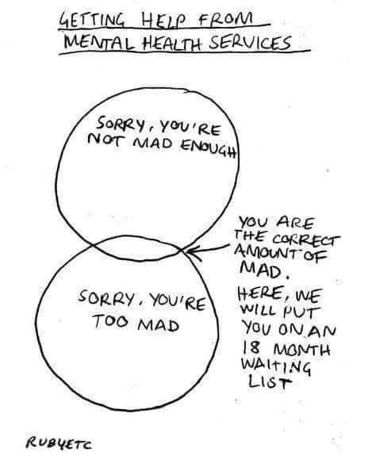
Lived experience of the gap

Slide 5


Why is there a gap between primary and secondary care? Who is in this gap?
£170m pa
spend in Devon secondary MH services
People with Eating Disorders; People with SMI: Schizophrenia; Bipolar; CEN/PD; Psychosis.
Prevalence:
c15,000
people in Devon
with “SMI”
Secondary care MH services
Core MH Teams
Specialist MH Services
Eating Disorder
CEN/PD
Rehab
HIGH SECONDARY CARE THRESHOLDS
People with Eating Disorders / Disordered Eating; people with SMI: Schizophrenia; Bipolar; CEN/PD; Psychosis, for whom the thresholds are too high.
Prevalence:
c42,000
people in Devon
in the “gap”
MIND THE GAP!
PEOPLE EXCLUDED FROM NHS TT
People with: Eating Disorders; SMI (Schizophrenia; Bipolar; CEN/PD; Psychosis); CMI for whom TT doesn’t work; or deemed “too risky” for TT; or as yet undiagnosed.
£800k pa
spend in Devon on people in the “gap”
Primary Care –
NHS Talking Therapies
£18.4m pa
spend in Devon on people with “Common Mental Illness” (NHS TT)
GP Surgery
NHS Talking Therapies
People with anxiety, depression, grief., panic attacks, PTSD, OCD, phobias.
Prevalence:
c130,000
people with “Common
Mental Illness” (CMI)
Notes:
Needs and Prevalence of the “missing middle” or “gap”
The articulation of these needs commonly includes people struggling with:
Complex Trauma experiences leading to a variety of consequences
Personality and PD difficulties
Bipolar Disorder
Recurrent Severe Depression
Eating Disorders (except severe)
Chronic Fatigue / ME
Co-morbid substance abuse
Self-harm
Those for whom NHS TT treatment has not been effective
Excluded from NHS TT _ insufficieltly housed and using drug / alcohol
Plymouyh options – handholding into harbour – a service –
Trauma stabilsation
Flex –
Aiutims – or wainting for diagnosis
Check with
Medication
GP –
Medication –
DMHA _
Trauma – PTSD TT / not cPTSD

Slide 6

Outline of Approach
Collaboration - Stronger partnerships between statutory services and VCSE organisations to improve outcomes.​
Areas of focus- Engagement , Training, Mapping and Shared Care / Data
Governance Model - universal consent model, consistent IG approaches and clear interface pathways
VCSE Training- Improved understanding of thresholds to enable referral flow. Trauma Informed practice and systems
Cultural Change - Transparent communication, shared responsibility and understanding of risk, and clear expectations.

Slide 7
Work to date:
MAPPING THE MATs
Briefing paper shared
Meetings/discussions with stakeholders
DPT intention and commitment, including training

Slide 8
Challenges
No additional resource to pump prime programme of work
IG agreements to share service user information
No shared IT platforms ( other than system1)
Where? To test this in the most fertile space?
Requires commitment from wide range of service providers
Needs to align to ongoing/developing neighbourhood working
Defining detailed scope to enable clarity and agreement

Slide 9
Enablers
Kerry, Tom and Rowan able to offer time and project support to scope and delivery
Willingness from DPT and DMHA to ‘start the ball rolling’
Ilfracombe/Bideford existing services to build upon? ( Truth poverty, Campus model)
Consider MAT team as foundation?
Seek support from North Neighbourhood steering group/MH partnership group aligned to OND
Learning from national sites and programmes available ( ie from other neighbourhood sites and IG model from Kent? )

Slide 10
Reflections and next steps:
Following rounds of discussions with stakeholders including members of DPT, RDUH, CVS, VCSE Assembly members:
Agreed Ilfracombe, Bideford and Torridge are areas for development in this space.
Further details needed on offer of Champions and PSW’s from DPT and how they can interface with Drop-ins and other existing pathways/forums with a view to enabling an improved understanding of the current flow.
Agreed governance via KD was to update the North MH group ( 19th March), OND programme group, RDUH MH assurance group, and DPT Prevention and Treatment meetings, then into one Ilfracombe for mobilising.
Suggest in person workshop to start mapping out where this work would offer he most impact/benefit, agreeing options and next steps.
Set up a task and finish group – a set of champions to take this work forward and report back into the North MH Group. Nominees needed from each partner. Consider how we can link into existing work – let us come to the existing table!
What is the role of the MAT’s in this space? – wide variance across the patch needs thinking about and the interface with Primary Care.

Slide 11
Lets discuss!

